Slide 1
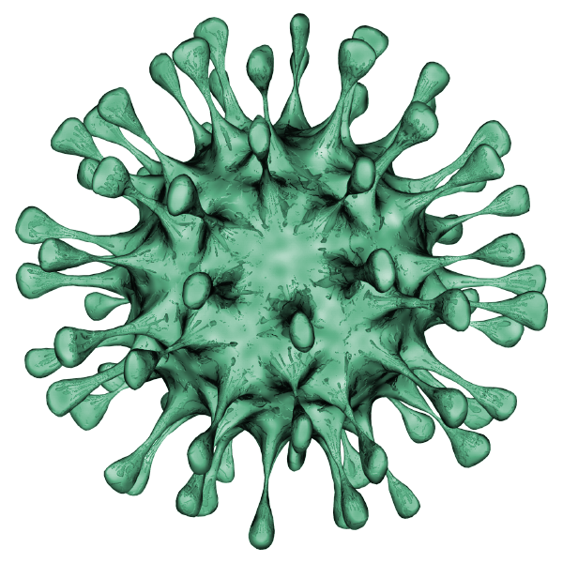

COVID-19 CLASSIFICATION USING CHEST X-RAY IMAGES
Presentation By-
Ankur Agrawal (20095010) Vivek Agrawal (20095126)

Slide 2
CONTENTS
PROJECT OBJECTIVE
FEATURE OF PROJECT
BLOCK DIAGRAM
PROPOSED SYSTEM ARCHITECTURE
CLASSIFICATION USING CNN AND FUZZY LOGIC
SYSTEM IMPLEMENTATION
RESULT
CONCLUSION

Slide 3
PROJECT OBJECTIVE
The aim of the project is to develop a novel deep neural network based model for highly accurate detection of COVID-19 infection from the chest X- Ray images of the patients.
The aim of our project is to make use of modern AI techniques to detect the COVID-19 patients using X-Ray images in an automated manner, particularly in settings where radiologists are not available, and help make the proposed testing technology scalable

Slide 4
FEATURES OF PROJECT
Early diagnosis is very essential for both early intervention to the patient and prevent the risk of transmission of the disease. In this Project we have presented a neural network architecture which will reduce overfitting.
It can also be used in situation where the possibilities are insufficient whether in terms RT-PCR test or doctor. We have used a fuzzy neural network instead of taking a fully connected layer for the feature information.
We all know that Convolutional neural network is an excellent feature extractor so integrating it with the fuzzy neural network will increase its accuracy in tests.

Slide 5
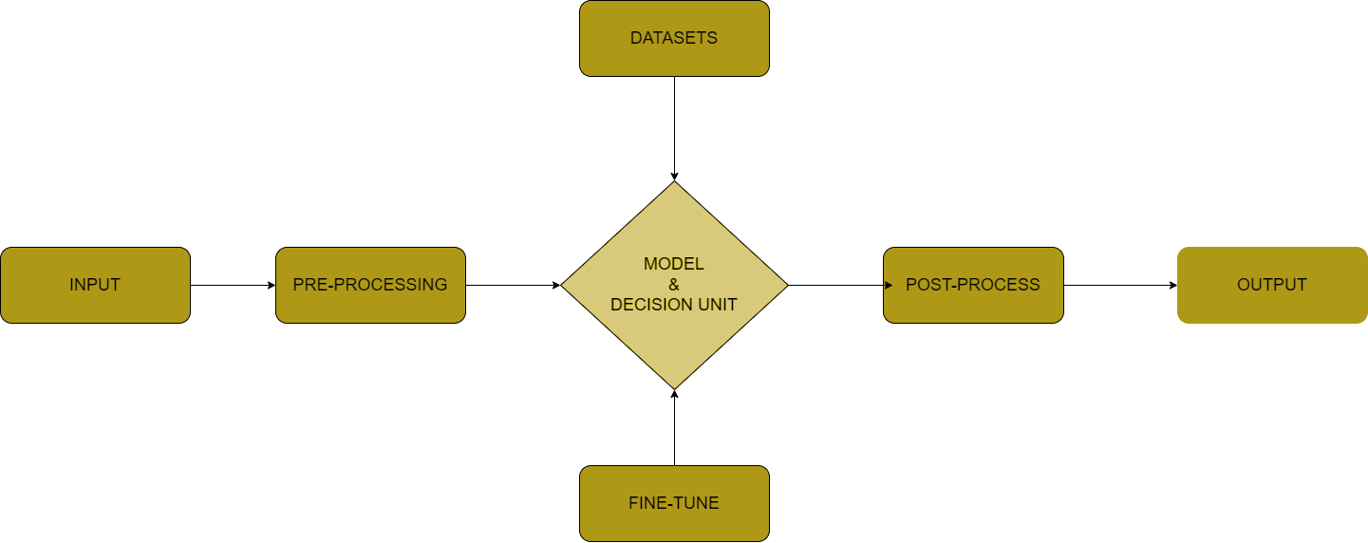
BLOCK DIAGRAM

Slide 6
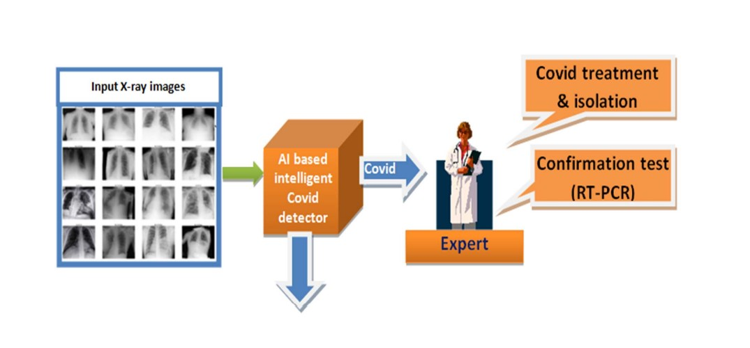
Proposed Systems Architecture

Slide 7
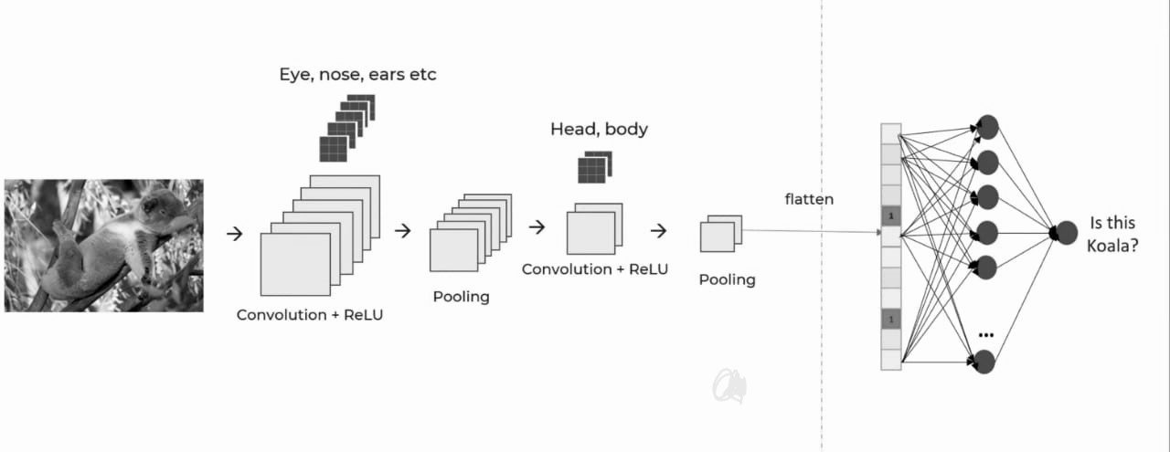
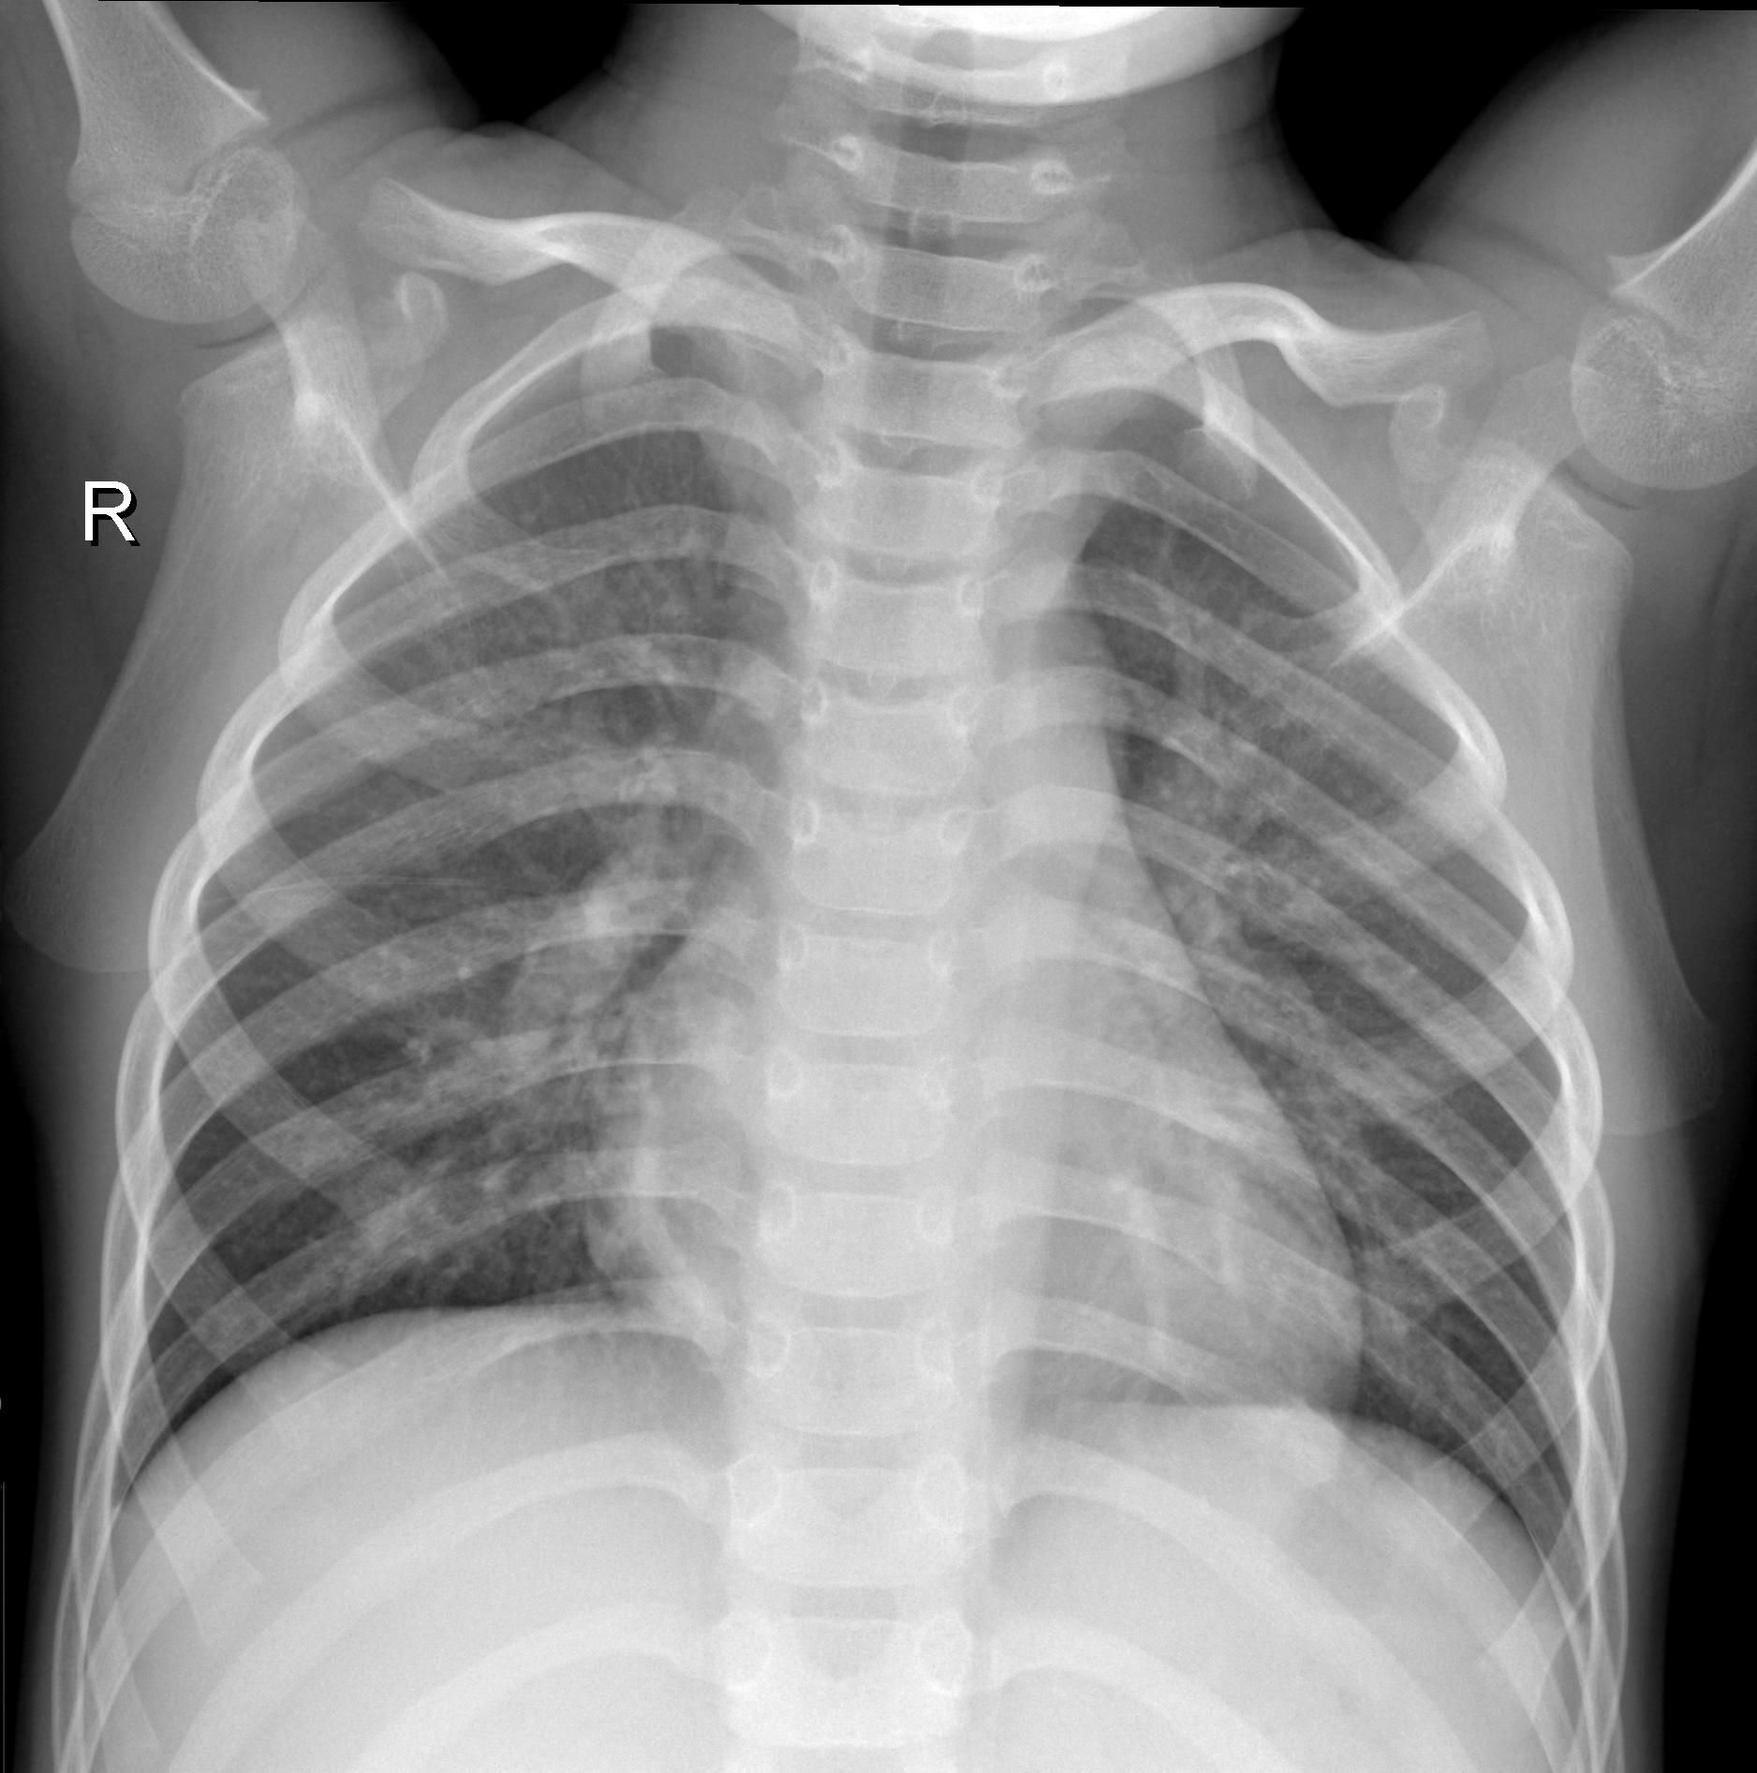
CLASSIFICATION USING CNN

Slide 8
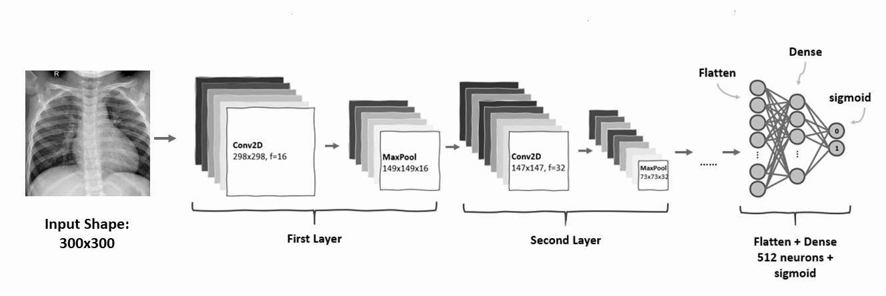

Slide 9
Convolutional Operation

Slide 10
MAX POOLING

Slide 11
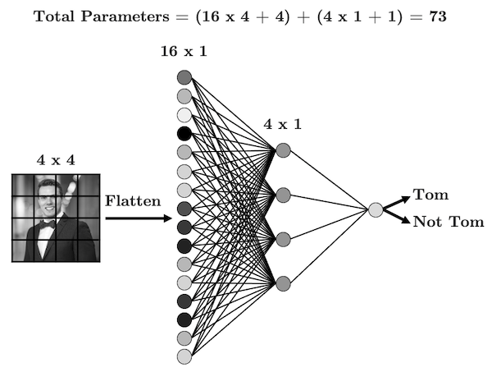
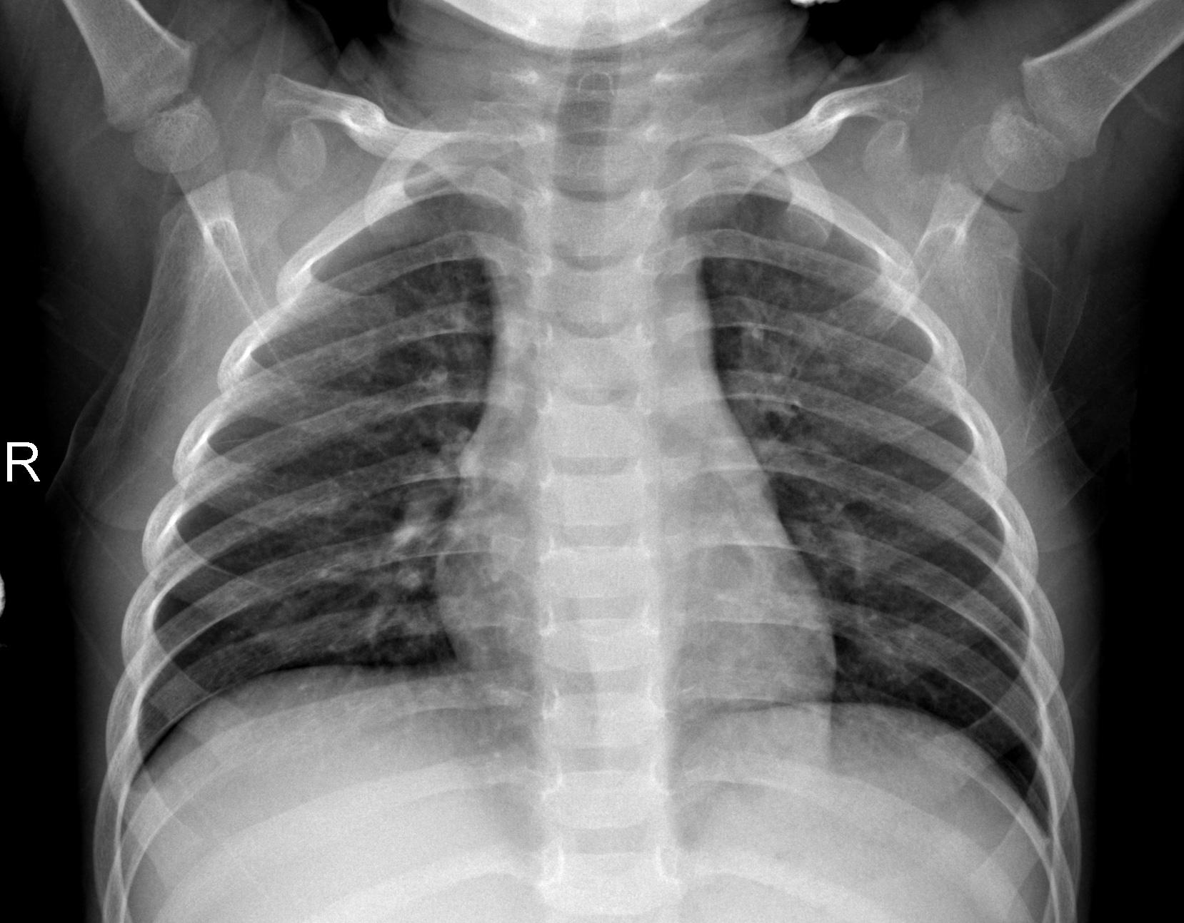
CLASSIFICATION

Slide 12
CLASSIFICATION USING FUZZY LOGIC
Fuzzy logic is a method that was introduced to handle a range of values between TRUE and FALSE. This model of reasoning has helped us to reach closer to human reasoning. Most of the models which work on crisp data set only give output in one of the two forms: False (Value 0) or True (Value 1), Negative (Value 0) or Positive (Value 1) but what if there are other possibilities like partially True or partially False.
A model which can produce the following possible decisions between FALSE and TRUE: Surely True, might be True, Not Sure about True or False, Might Be False, surely False. All these decisions can be achieved with the help of Fuzzy logic.
A. Fuzzy Based Image Processing
B. Fuzzy Based Classification on X-ray Images

Slide 13
Fuzzy Based Classification on X-ray Images
Feature Extraction:
In pattern classification, we use features like color, shape, spatial location, and texture. It is not suitable to consider color and texture features for x-ray image classification. The reason is that x-ray images are gray-scale images, and their texture characteristics are remarkably similar. It is recommended to use combinations of texture and shape features together.
Histogram Adjustment
Noise Removal
Edge Detection

Slide 14
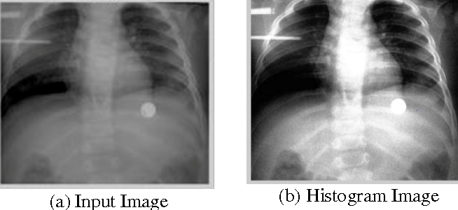

Slide 15
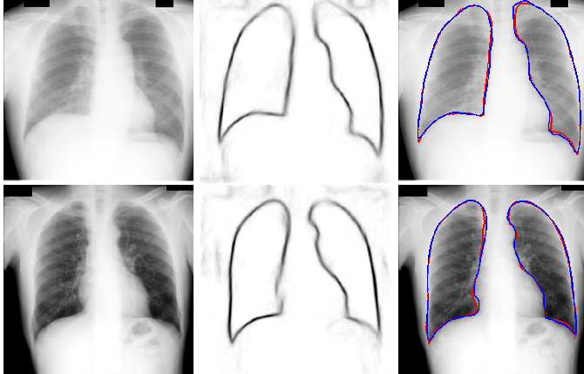
Edge Detection

Slide 16
System Implementation and Algorithm
We have taken datasets that are publicly available. As we are doing binary
classification, we have taken positive covid 19 X-ray images from the GitHub
repository which is being updated by a group of doctors on a regular basis. As
we wanted a balanced dataset therefore, we have taken the same number of
normal X-ray images from Kaggle as we have taken from GitHub repository.
Link : GitHub - ieee8023/covid-chestxray-dataset: We are building an open database of COVID-19 cases with chest X-ray or CT images.

Slide 17
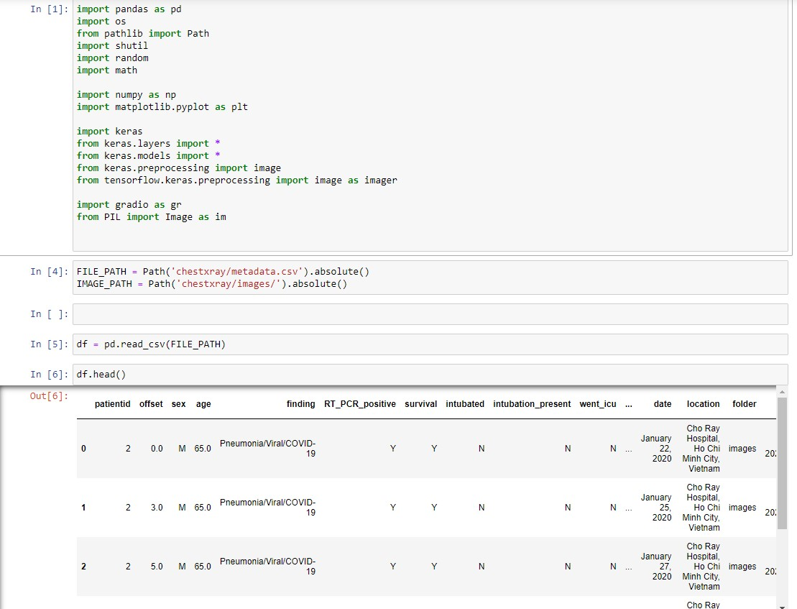

Slide 18
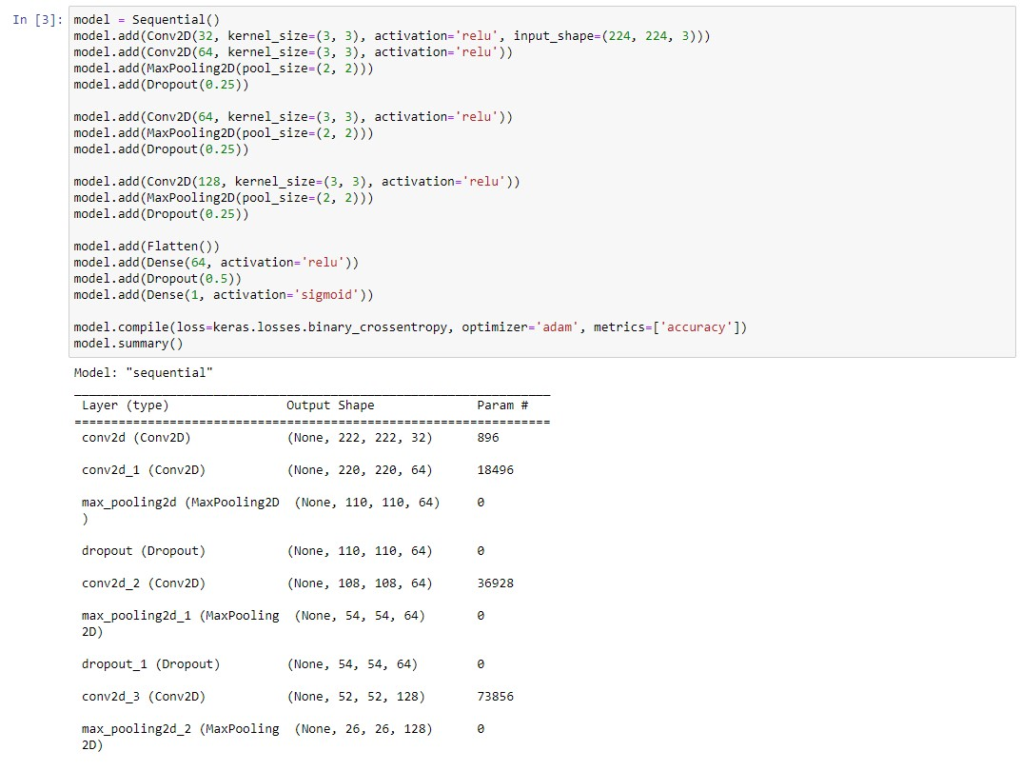

Slide 19
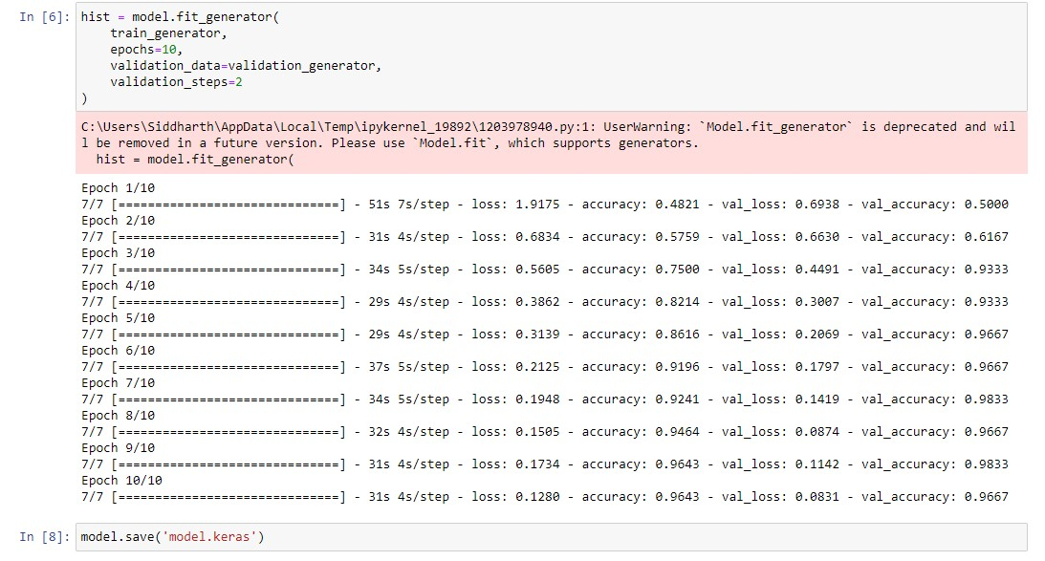

Slide 20
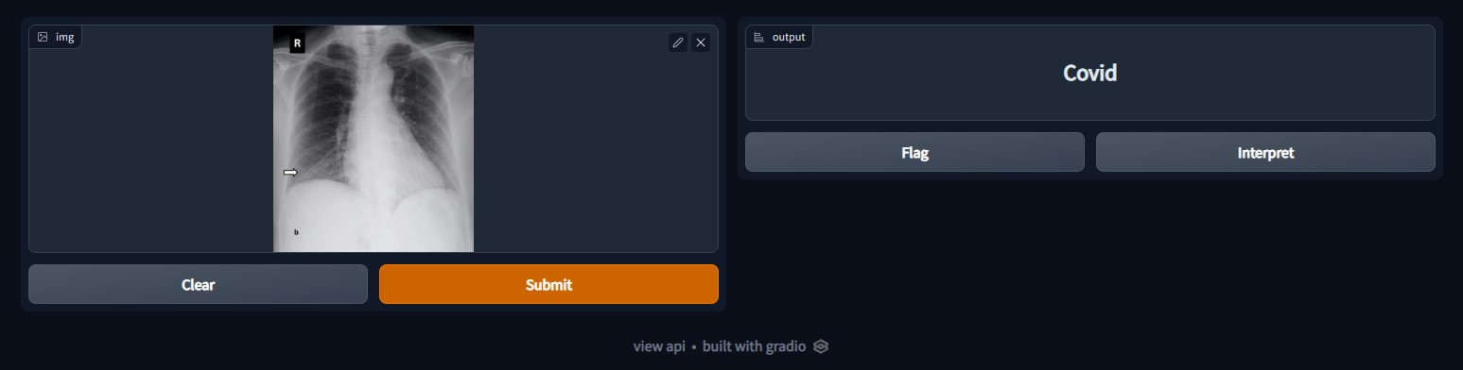
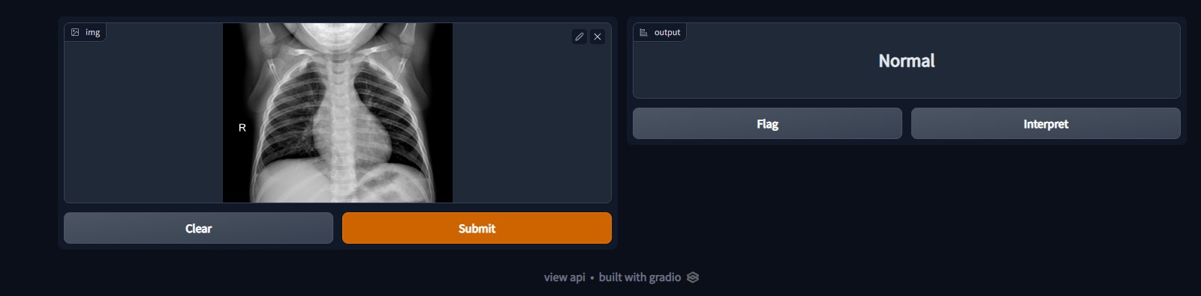
RESULTS

Slide 21
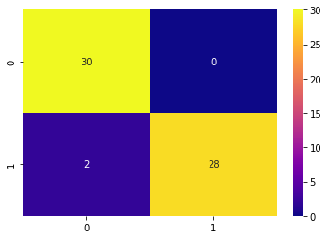
Conclusion
Early diagnosis is very essential for both early intervention to the patient and prevent the risk of transmission of the disease. In this Project we have presented a neural network architecture which will reduce overfitting. It can also be used in situation where the possibilities are insufficient whether in terms RT-PCR test or doctor.

Slide 22

Thank You !!!
ANY QUESTIONS ?

